Slide 1

Cybersecurity
In
Parallel
A Presentation By
Scot Matson
(V)

Slide 2
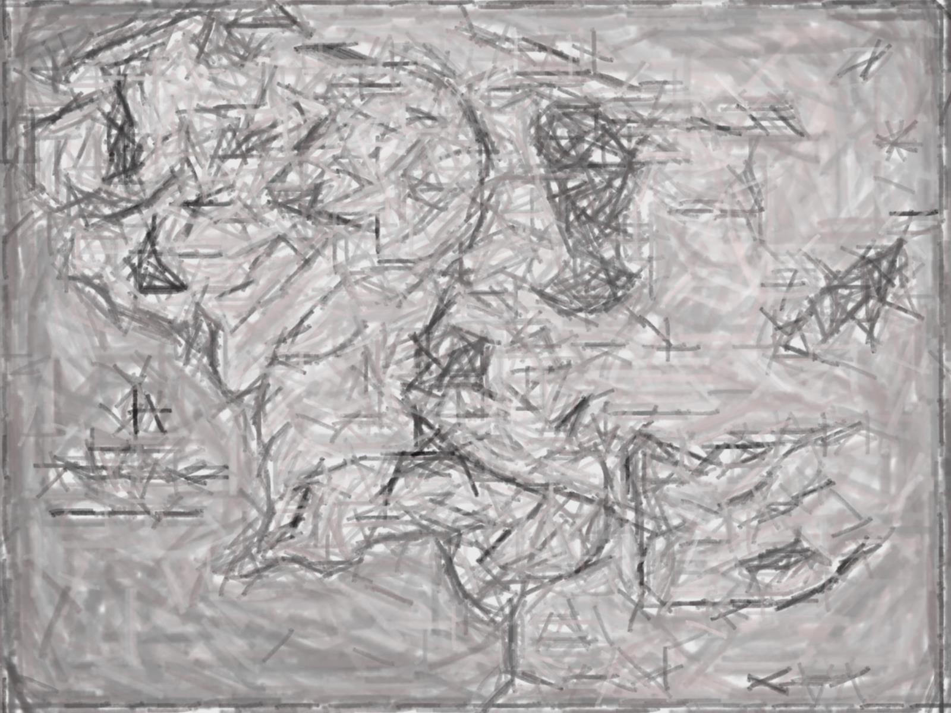
R
oadmap
Epoch
APT
Lexicon
Mordor
Stagnation

Slide 3
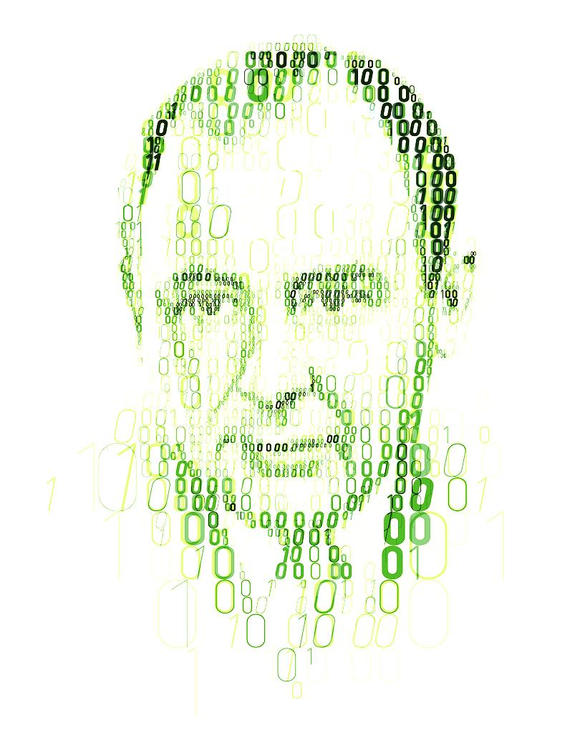
John
Von Neumann
1949
"Computing Machines in General"
"Rigorous Theories of Control and Information"
"Theory and Organization of
Complicated Automata“
"The Role of High and of Extremely High Complication"
"Re-evaluation of the Problem of Complicated Automata: Problems of Hierarchy and Evolution“
Notes:
Self-replicating virus theorized in lecture #3
1966
University of Illinois
“Theory of Self-Reproducing Automata”

Slide 4


Bob Thomas
Ray Tomlinson
1971
1972
I’M THE CREEPER: CATCH ME IF YOU CAN

Slide 5
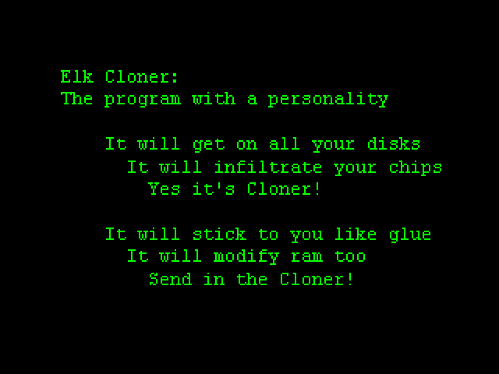
Richard Skrenta
1981-1982
Notes:
Author: Richard Skrenta, 15 years old
Target: Apple II Series: Apple DOS 3.3
Type: “Boot Sector Virus”
Executed on 50th play
Effect: Unintentionally overwrote reserve tracks in memory

Slide 6

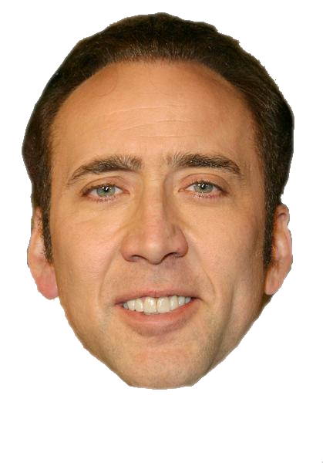

Notes:
1983 War Games released
1984 NSDD-145 passed

Slide 7
First Distributed Denial of Service Attack
Disabled 10% of the Internet
All because of a bug
THE MORRIS WORM
1988
Notes:
Robert Morris
Self-replicating worm that exploited sendmail, finger, rsh/rexec, and weak passwords
Bug in recognition accelerated spread leading to first DDoS attack and disabled 10% of the internet (60,000 computers)
Outcome
Computer Fraud and Abuse Act of 1986
DARPA funds Computer Emergency Response Team Coordination Center (CERT/CC) @ Carnegie-Melon University
NSD-42 (replaces NSD-145)

Slide 8

WorldWideWeb
Nexus
DNS
TCP
HTTP
HTML
ENQUIRE
CERN
HYPERTEXT

Slide 9
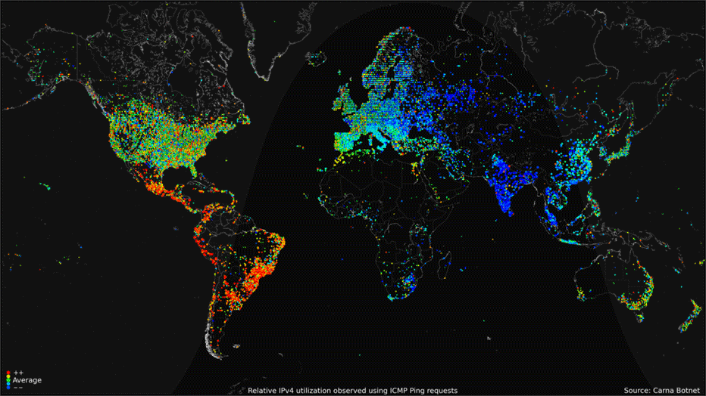
… the more vulnerable we become.
3,424,971,237 current users
The more connected we are …
46% of the world’s population is online
238,975,082 new subscribers per year
1,021,823,603+ registered web domains
Notes:
2012 Internet Census
24 Hours of data illegally collected with a BotNet of 500K hacked computers
High Use = Yellow/Red
Low Use = Green/Blue

Slide 10
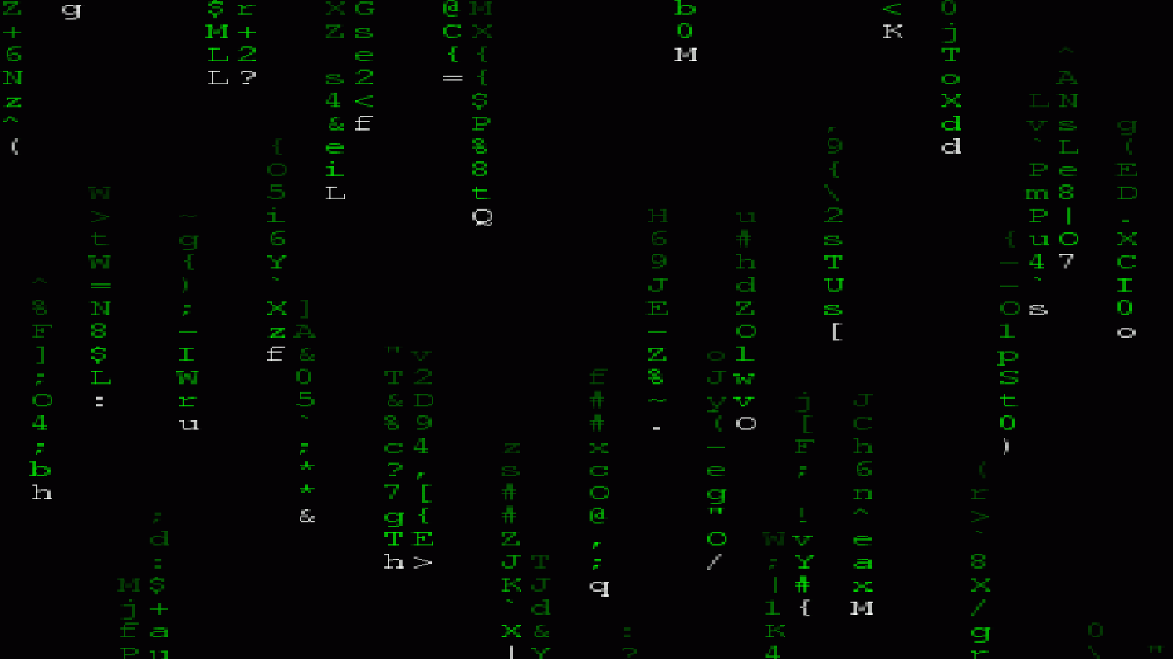
malwareVECTORS
Phishing
Watering Holes
Trojans
Zero Day
DDoS
Social Engineering
DNS Spoofing
Scareware
Bots / Botnet
Injection
Cross-Site Scripting
Eavesdropping
Port Scanning
Brute Force
Exploit Kits
Malvertising

Slide 11
malwarePAYLOADS
Spyware
Backdoors
Rootkits
Ransomeware
Browser Hijacking
Shared Libraries
Worms
RATs
Buffer Overflow
Logic Bomb
Viruses
Fork Bomb

Slide 12
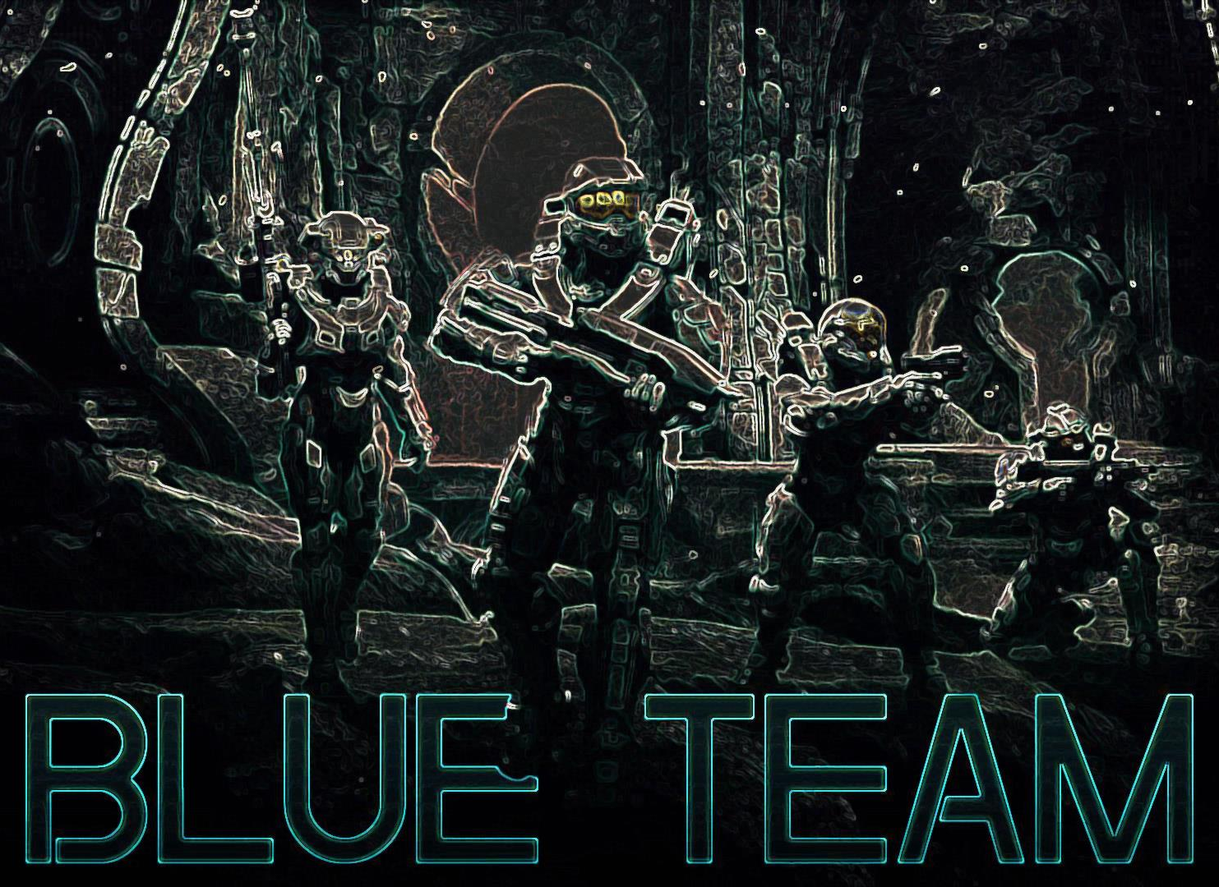
Firewalls
Anti-Virus
Timeout Functions
Sensor Boxes
Access Control
Masking
Intrusion Detection
Honeypots
Patching
Awareness
Encryption
Backup
Authentication
Integrity
Behavioral
Signatures

Slide 13
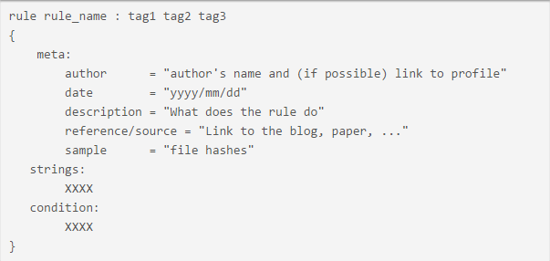
more on signatures
Code Analysis
Packet Analysis
Disassemblers
Debuggers
Vim
Wireshark
IDA Pro
OllyDbg

Slide 14
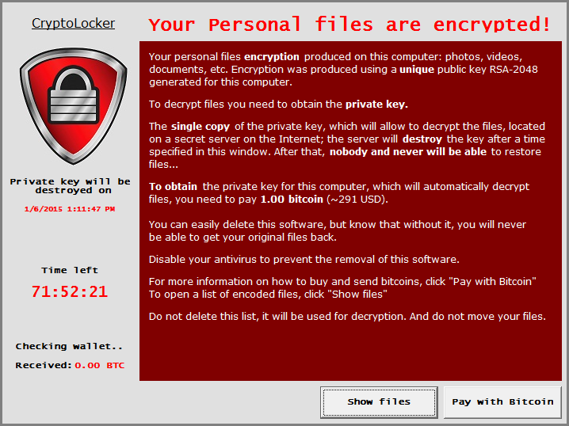
more on signatures
rule CryptoLocker_set1 {
meta:
author = "Christiaan Beek, Christiaan_Beek@McAfee.com"
date = "2014-04-13"
description = "Detection of Cryptolocker Samples“
strings:
$string0 = "static"
$string1 = " kscdS"
$string2 = "Romantic"
$string3 = "CompanyName" wide
$string4 = "ProductVersion" wide
$string5 = "9%9R9f9q9"
$string6 = "IDR_VERSION1" wide
$string7 = " </trustInfo>"
$string8 = "LookFor" wide
$string9 = ":n;t;y;"
$string10 = " <requestedExecutionLevel level"
$string11 = "VS_VERSION_INFO" wide
$string12 = "2.0.1.0" wide
$string13 = "<assembly xmlns"
$string14 = " <trustInfo xmlns"
$string15 = "srtWd@@"
$string16 = "515]5z5"
$string17 = "C:\\lZbvnoVe.exe" wide
condition:
8 of ($string*)
}

Slide 15
Slack
LinkedIn
Steam
US Military
British Airways
US Voter Database
Verizon
Ashley-Madison
Apple
JP Morgan Chase
Why do we continue to fail
at cybersecurity?
Facebook
eBay
eHarmony
Mozilla
Code.org
Nintendo
Uber
Sony
Dropbox
Anthem
Target
Home Depot
US Government
Yahoo!
Adobe
AT&T
RSA
Notes:
Too many governing bodies involved
Financial motivations
Passive reactionary
Stuck in the 90’s
Evolving organized threat → APT

Slide 16

Advanced Persistent Threat
Reconnaissance
Delivery
Intrusion
Command & Control
Lateralization
Exfiltration
Notes:
APT

Slide 17


Big Data
is a
Cybersecurity
Challenge
Parallel
Processing
is a Big Data
Solution
-but-

Slide 18
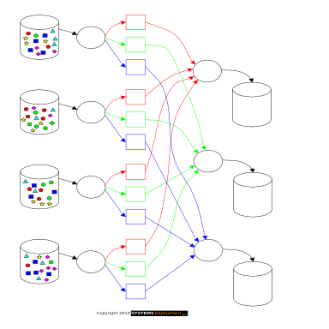
Map
Reduce
map(String key, String value):
// key: document name
// value: document contents
for each word w in value:
EmitIntermediate(w, “1”);
reduce(String key, Iterator values):
// key: a word
// value: a list of counts
int result = 0;
for each v in values:
result += ParseInt(v);
Emit(AsString(result));
Notes:
A Model for parallelisation
Inspired by LISP
Custom functions

Slide 19
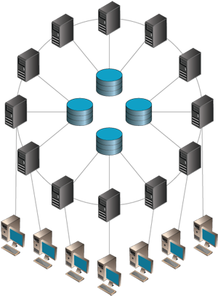
DistRibuted Systems
Notes:
Distributed Systems

Slide 20
DistRibuted file Systems
DistRibuted Systems
Local
Remote
HDFS
Quantcast
Lustre
Ori
•
•
Amazon S3
Google Cloud
MS Azure
•
•
•

Slide 21




NoSQL
Notes:
Shallow + Wide vs. Deep + Narrow

Slide 22
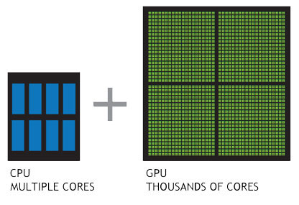
Harnessing The Power of
The GPU
Notes:
GPGPU

Slide 23
Parallelizing Cybersecurity
Pros
Improved cryptographic algorithms
Maximized crawler download rate
Near real-time analysis of large data sets
Notes:
Examples of implementation

Slide 24
Parallelizing Cybersecurity
Cons
More effective brute force attacks
Faster data exfiltration
Notes:
Examples of implementation

Slide 25
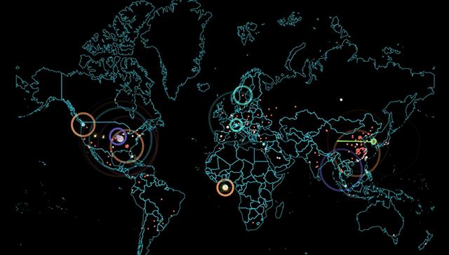
Cybersecurity is an Arms Race
Notes:
Conclusion

